Slide 1
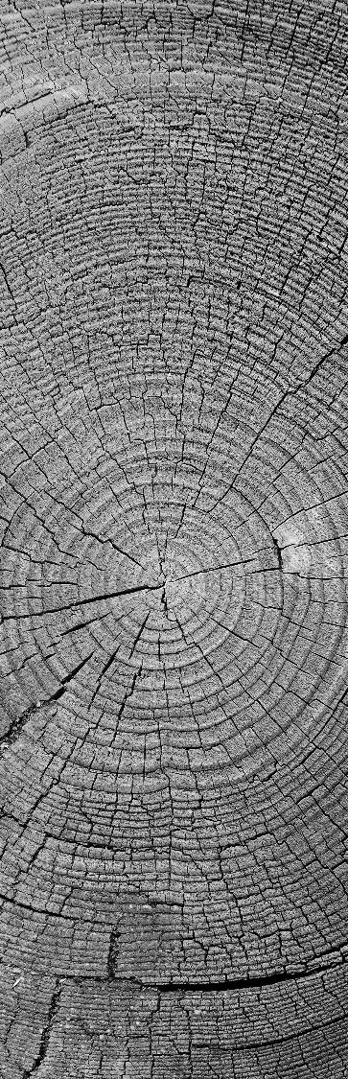

DECISION TREES FOR CLASSIFICATION
Understanding, Building, and Evaluating Decision Trees

Slide 2
What is a decision tree?
Root Node, Decision Nodes, Leaf Nodes

Slide 3
Decision trees
Root Node, Decision Nodes, Leaf Nodes
A Decision Tree in Machine Learning is a supervised learning algorithm used for classification and regression.
Root Node: This node represents the whole dataset and the first split.
Decision Nodes: The nodes where features are split, tests lead to branches.
Leaf Nodes: Terminal nodes that represent the final output by predicted class or value.

Slide 4
Why Use Decision Trees?
For Following Reasons

Slide 5
Reasons to use decision trees
Easy to analyze and understand as it needs minimal preprocessing for data.
Handles both the numerical and categorical data effectively.
Decision trees can provide a clear visualization of decision making process.
It can capture non linear relationship between features.
Decision trees automatically performs feature selection during the splitting.
Maintains performance even with noisy oust data ensuring efficiency.

Slide 6
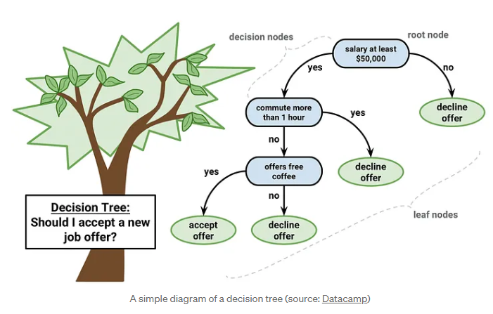

Slide 7
Metrics for Splits
Gini Impurity
Information Gain

Slide 8
metrics for splits
Gini Impurity:
Gini Impurity measures the impurity level in dataset its also known as Gini impurity.
Lower Gini Impurity value indicates that it is a purer and more effective split.
Thus metrics is used in classification tasks to find the best feature for splitting.
Information Gain:
This metrics measures the decrease in entropy after a split.
A higher Information Gain value indicates a more better split.
Helps in finding which feature provides the most information about the target variable.

Slide 9
Gini Impurity
Gini Impurity: It measures the probability of misclassification.
Formula: Gini = 1 - Σ(pᵢ²)o
Example: In a dataset with 40% apples and 60% oranges:
Gini = 1 - (0.4² + 0.6²) = 0.48
Lower Gini value means a better split.

Slide 10
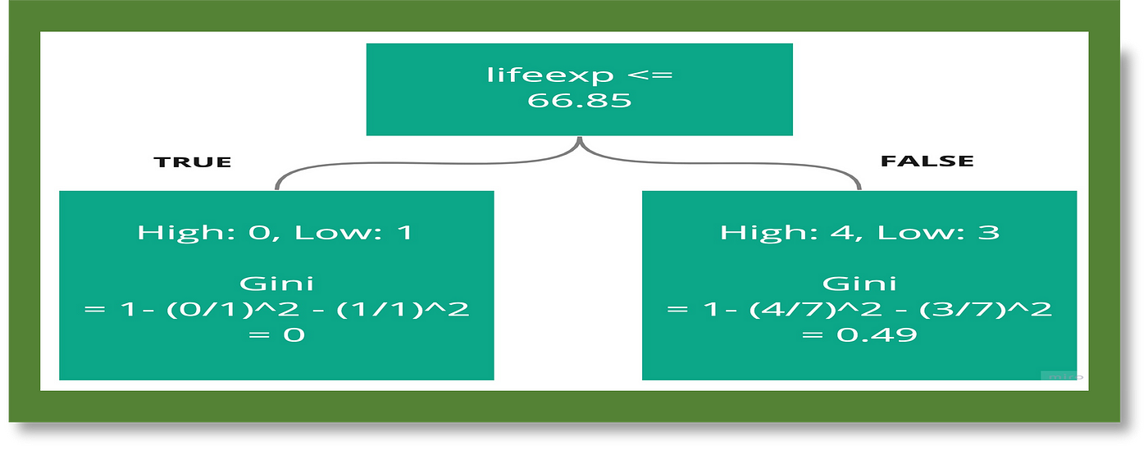
G. OpenAI, "Understanding Pruning and Gini Impurity: A Simple Guide for Decision Tree Enthusiasts," GOpenAI Blog, [Online].
Available: https://blog.gopenai.com/understanding-pruning-and-gini-impurity-a-simple-guide-for-decision-tree-enthusiasts-a534f2560e36

Slide 11
Information Gain
Information Gain: This metric measures how much a split has improved the classification.
Formula: Info Gain = Entropy(Parent) - Weighted Avg[Entropy(Children)]
It provides splits that results in purer and cleaner subsets.
We can use criterion='entropy' in scikit-learn to trains the model using Information Gain.

Slide 12
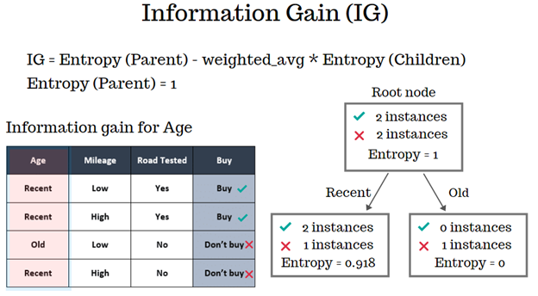
G. Kaur, "Decision Tree – Part 2," Towards Data Science, Jun. 2019. [Online].
Available: https://towardsdatascience.com/decision-tree-part-2-34b31b1dc328

Slide 13
Building a Decision Tree
Split
Train
Evaluate

Slide 14
Decision Tree implementation
Key Steps
Importing relevant Libraries.
Loading Iris Dataset.
Visualize Class Distribution.
Preprocess Data (Train-Test Split).
Train Model.
Evaluate Model.
Visualizing The Decision Tree.

Slide 15
dataset insights
Iris Dataset

Slide 16
Dataset insights:
Dataset used: Iris Dataset
Features:
Petal width, Petal length, Sepal length, Sepal width
Target Classes
Versicolor, Setosa, Virginica
The dataset is balanced containing 50 samples per class

Slide 17
Model evaluation
Confusion Matrix
Classification Report
Accuracy

Slide 18
Evaluating the model
Confusion Matrix:
A visual representation of correct and incorrect predictions made by the model.
Accuracy Score:
Indicated overall percentage of correct predictions made by the model.
Classification Report:
This report provides the important metrics like Precision, Recall and F1-score to assess model.

Slide 19
Feature Importance
Features in Model Prediction

Slide 20
Feature importance
In Model Prediction
Indicates how much each of the feature contributes to the prediction of the model.
Assists in identifying the feature which has the most influential features.
Example:
In Iris dataset the most important features are often petal width and petal length,.

Slide 21
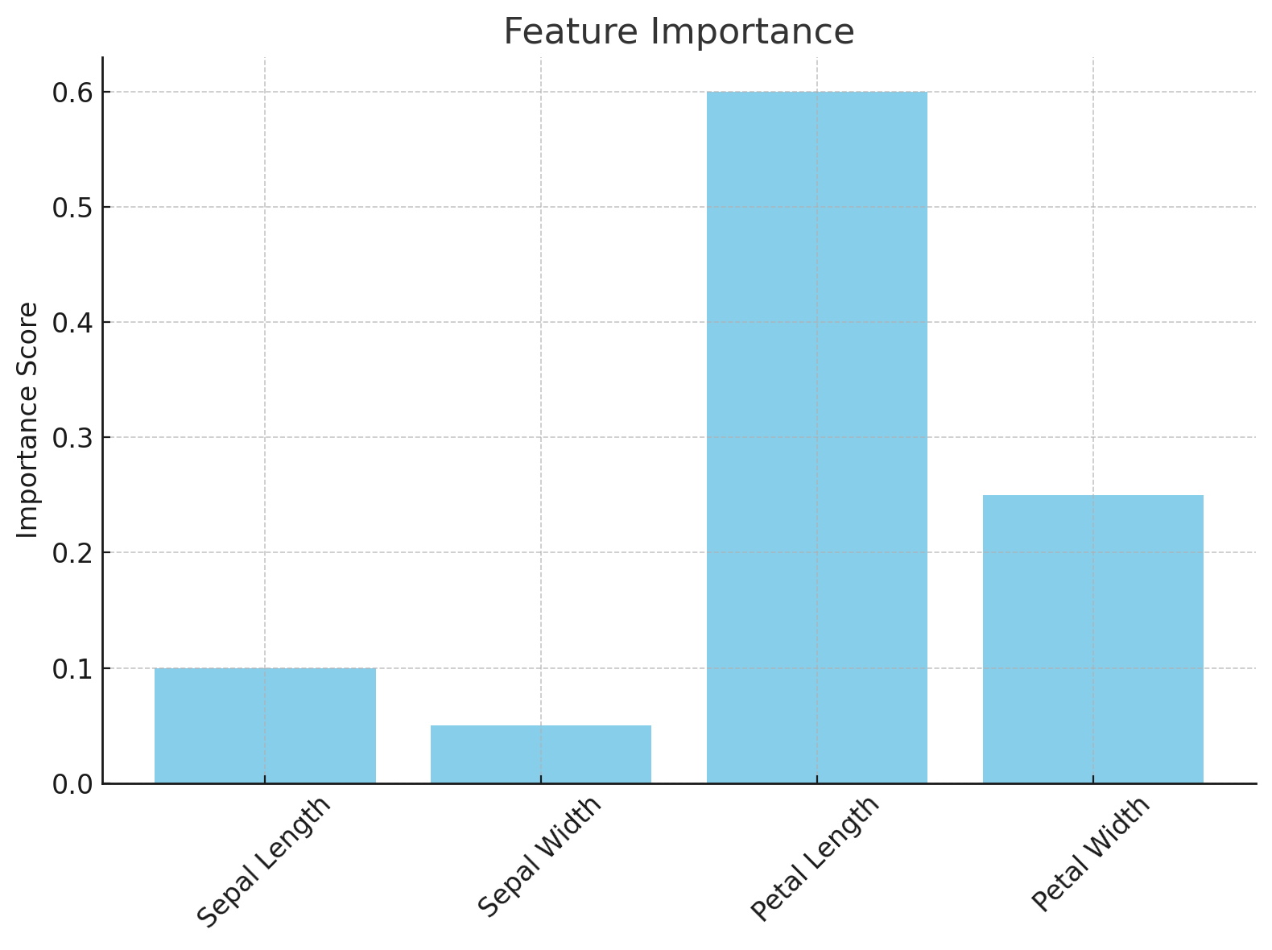
Example
Notes:
Jupyter Notebook walkthrough from here.

Slide 22
Conclusion
Key Insights & Future Enhancements

Slide 23
Conclusion & future enhancements
Decision Trees are interpretable and perform well in classification tasks.
The effectiveness can be evaluated through metric like Precision, Accuracy and F1-Score.
Evaluating on different and larger datasets.
Optimizing the hyper parameters like maximum depth etc.
Comparing with advanced models like Random Forest.

Slide 24
THANK YOU
WOODGROVE BANK

